Slide 1
CISC 4006 Brains & Behaviors in Beasts & Bots
The Braitenros Python Package
(ROS implementation of Braitenberg Vehicles)

Slide 2
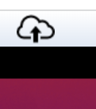

Getting started
First you need to copy the braitenros.py file from Blackboard into your Apporto home folder.
Easy Method:
Step 1: Download this file from blackboard into your PC
Step 2: Press the Apporto upload button (a cloud with arrow going upwards)
Step 3: Move the uploaded file from your Desktop folder to your home folder
Either:
Drag and drop using the ‘file cabinet’ or
At the command prompt (ie ‘$’ ) type: mv ./Desktop/braitenrosT3.py .

Slide 3
Getting started
First you need to copy the braitenros.py file from Blackboard into your Apporto home folder.
Other Methods:
1. Start the firefox browser that is within Apporto, goto blackboard, and download braintenbergT3.py into the Downloads folder.
Move it from there to you home folder using the file cabinet icon or typing the linux command.
2. Download braitenbergT3.py to your laptop and open as a text file. Select and copy all the text.
On Apporto, type “gedit braitenbergT3.py” to bring up the text editor and past all the text you copied into it. Save the file and end gedit.

Slide 4
Getting start
Next:
To design a Braitenberg vehicle, you will need to
edit a file and
write a short description of the vehicle you want to build
Use “gedit” to edit your file. gedit is a text editor program like Notepad
Lets say you want to name the file vehicle1.py --- notice it will need to end with “.py” because in fact this will be a python program file
Then you would type “gedit vehicle1.py” and press enter.

Slide 5
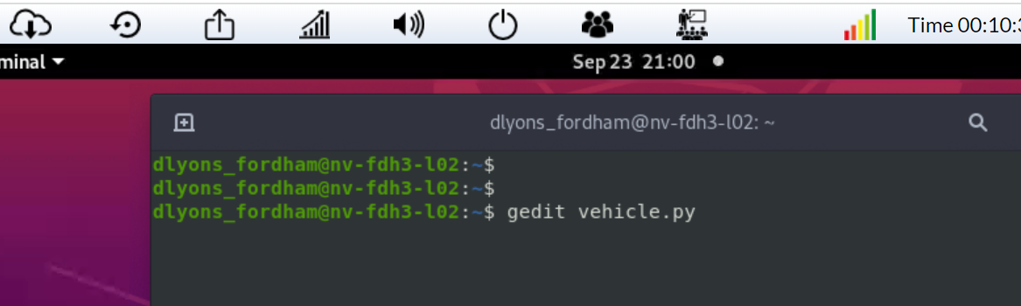
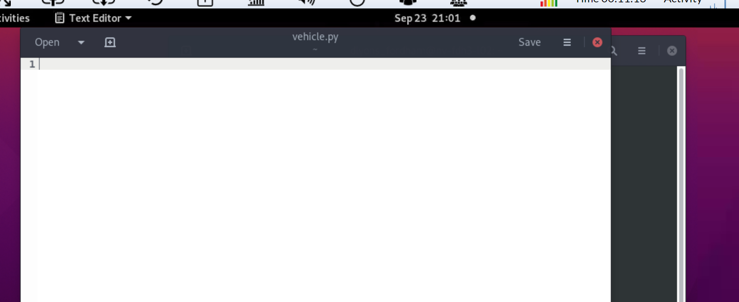
Editing vehicle1.py

Slide 6
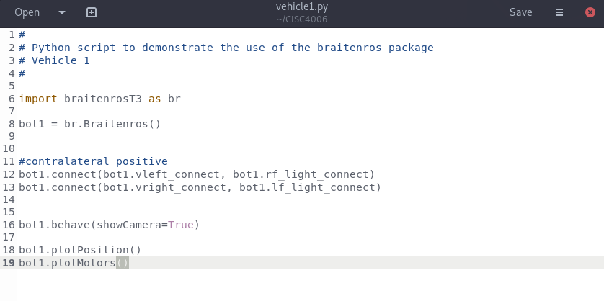
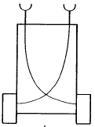
Braitenros
lf_light rf_light
vleft vright

Slide 7
Braitenros
lf_light rf_light
vleft vright

Slide 8
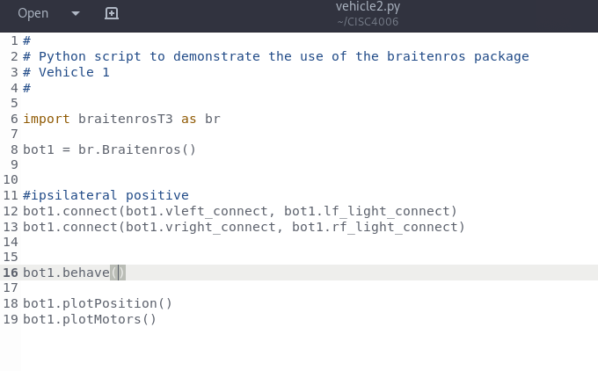
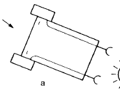
Braitenros
lf_light rf_light
vleft vright

